Slide 1
“Epilogue: What happened after the Battle of Marathon”
John Marincola

Slide 2
The Marathon Soros

Slide 3
The New Marathon inscription
The inscription was discovered at the villa of Herodes Atticus, a 2nd century CE orator and public benefactor. The inscription is a casualty list of the fallen from the Erechtheis tribe.

Slide 4
The Marathon inscription discovered at the villa of Herodes Atticus

Slide 5
From the new Marathon stele:
Fame, as it reaches the furthest limits of the sunlit earth,
(or perhaps better: Fame, ever brilliant as she seeks out the ends of the earth,)
shall learn the valour of these men: how they died
fighting the Medes, and placed a crown on Athens,
the few, accepting battle against many.

Slide 6
The Callimachus Monument being unveiled at the Acropolis Museum

Slide 7
Inscription on the Callimachus Monument
Upper line: AΦIΔNAI (= Aphidnai-)
Lower line (at beginning): MARXO (= marcho-)

Slide 8
Central Greece with Thebes and Plataea

Slide 9
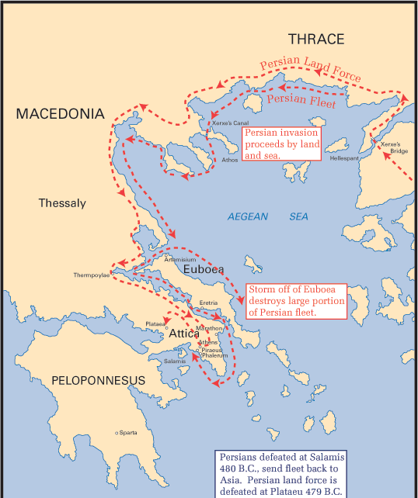

Slide 10
Site of Thermopylae today

Slide 11
Thermopylae

Slide 12
Artemisium on the n.w. coast of Euboea

Slide 13
The isthmus of Corinth leading into the Peloponnese

Slide 14
Map showing Troezen
The Athenians, when evacuating their city, in 480 BCE moved the women and children into a number of cities, including Troezen, Aegina and Salamis. In the 1960s an inscription was discovered in Troezen, the ‘Decree of Themistocles’.

Slide 15
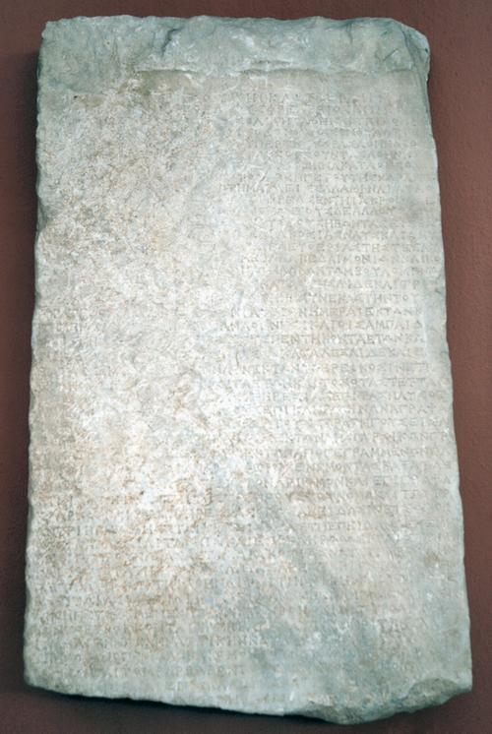

Slide 16
Battle at Salamis, 480 BCE

Slide 17
The Plain of Plataea

Slide 18
Topography of Plataea with Mt Cithaeron (at the Greeks’ back) and the Persian camp across the Asopus

Slide 19
Possible movements of troops in the battle of Plataea

Slide 20
Herodotus 9.62-63
First, there was a struggle at the barricade of shields; then, the barricade down, there was a bitter and protracted fight, hand to hand, close by the temple of Demeter, for the Persians would lay hold of the Spartan spears and break them; in courage and strength they were as good as their adversaries, but they were deficient in armour, untrained, and greatly inferior in skill. Sometimes singly, sometimes in groups of ten men – perhaps fewer, perhaps more – they fell upon the Spartan line and were cut down. They pressed hardest at the point where Mardonius fought in person – riding his white charger, and surrounded by the thousand Persian troops, the flower of the army. While Mardonius was alive, they continued to resist and to defend themselves, and struck down many of the Lacedaemonians; but after his death, and the destruction of his personal guard – the finest of the Persian troops – the remainder yielded to the Lacedaemonians and took to flight.
Translated by A. de Sélincourt,
revised by J. Marincola
(Penguin Books 2003)

Slide 21
Aegean Sea

Slide 22
The Promontory of Mycale

Slide 23
The site of the battle of the Eurymedon
According to the tradition, Cimon, the son of Miltiades (the victor at Marathon) , won a double victory by land and sea against the Persians at the battle of the Eurymedon river in ?467 BCE.

Slide 24
Next:
Tuesday, September 20, 2011 The Battle of Marathon: 2,500 years ago today Professor Paul Cartledge A.G. Leventis Chair Greek Culture, Cambridge University Chairman Marathon2500 7pm New York time Bard College in New York (webcast/audio for global audience)

Slide 25
Next:
Tuesday, September 20, 2011 The Battle of Marathon: 2,500 years ago today Professor Paul Cartledge A.G. Leventis Chair Greek Culture, Cambridge University Chairman Marathon2500 7pm New York time Bard College in New York (webcast/audio for global audience)
http://Marathon2500.org

